Slide 1
Chapter 13
Classes and Objects

Slide 2
List of contents
Creating a class
The self variable
Constructor
Types of variables
Namespaces
Type of Methods
Instance methods
Class methods
Static methods
Passing members of one class to another class
Inner classes

Slide 3
Introduction
We know that a class is a model or plan to create objects. This means, we write a class with the attributes and actions of objects. Attributes are represented by variables and actions are performed by methods.
So, a class contains variable and methods. The same variables and methods are also available in the objects because they are created from the class. These variables are also called 'instance variables' because they are created inside the instance (i.e. object).
Please remember the difference between a function and a method. A function written inside a class is called a method. Generally, a method is called using one of the following two ways:
classname.methodname()
instancename.methodname()

Slide 4
The general format of a class is given as follows:
class Classname (object) :
""" docstring describing the class """
attributes
def __init__(self) :
------
def method1() :
-----------
def method2() :
-----------

Slide 5
Creating a class
A class is created with the keyword class and then writing the Classname. After the Classname, 'object' is written inside the Classname.
This 'object' represents the base class name from where all classes in Python are derived. Even our own classes are also derived from 'object' class. Hence, we should mention 'object' in the parentheses. Please note that writing 'object' is not corn since it is implied
The docstring is a string which is written using triple double quotes or triple sinle quotes that gives the complete description about the class and its usage. The docstring is used to create documentation file and hence it is optional.
'attributes' are nothing but variables that contains data.
__init__(self) is a special method to initialize the variables.
method1() and method2() are the methods that are intended to process variables

Slide 6
If we take 'Student' class, we can write code in the class that specifies the attributes and actions performed by any student.
For example, a student has attributes like name, age, marks, etc. These attributes should be written inside the Student class as variables.
Similarly, a student can perform actions like talking, writing, reading, etc. These actions should be represented by methods in the Student class.
So, the class Student contains these attributes and actions
Go to Jupyter notebook for example

Slide 7
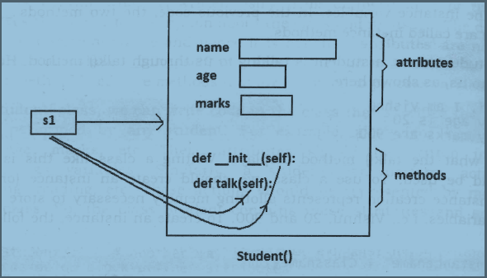

Slide 8
The self variable
‘self’ is a default variable that contains the memory address of the instance of the current class. So, we can use ‘self’ to refer to all the instance variables and instance methods.
When an instance to the class is created, the instance name contains the memory location of the instance. This memory location is internally passed to ‘self’
‘self’ is very much similar to ‘this’ keyword in java.
For example, we create an instance to Student class as:
s1= Student()
Here, ‘s1’ contains the memory address of the instance. This memory address is internally and by default passed to 'self' variable. Since 'self' knows the memory address of the instance, it can refer to all the members of the instance.

Slide 9
We use ‘self’ in two areas
The 'self variable is used as first parameter in the constructor as:
def __init__(self):
In this case, ‘self’ can be used to refer to the instance variables inside the constructor.
'self' can be used as first parameter in the instance methods as:
def talk(self):
Here, talk() is instance method as it acts on the instance variables. If this method wants to act on the instance variables, it should know the memory location of the instance variables. That memory location is by default available to the talk() method through ‘self’

Slide 10
Constructor
In python, constructor is a special method that is used to initialize the instance variables of a class.
In the constructor, we create the instance variables and initialize them with some starting values.
The first parameter of the constructor will be ‘self’ variable that contains the memory address of the instance
In python, special function __init__ will behave like constructor
It can have only ‘self’ as default parameter or it can have other parameters along with the ‘self’ depending on the way programmer needs to define.
Go to Jupyter notebook for examples

Slide 11
Types of variables
The variables which are written inside a class are of 2 types:
Instance variables: Instance variables are the variables whose separate copy is created in every instance (or object)
Class variables or Static variables: Class variables are the variables whose single copy is available to all the instances of the class. If we modify the copy of class variable in an instance, it will modify all the copies in the other instances.
Go to Jupyter notebook for examples

Slide 12
namespace
A namespace represents a memory block where names are mapped (or linked) to objects. Suppose we write:
n = 10
Here, 'n' is the name given to the integer object 10.
Please recollect that numbers, strings, lists etc. are all considered as objects in Python.
The name 'n' is linked to 10 in the namespace.
A class maintains its own namespace, called 'class namespace'.
In the class namespace, the names are mapped to class variables. Similarly, every instance will have its own name space, called 'instance namespace'. In the instance namespace, the names are mapped to instance variables.
In the following code, 'n' is a class variable in the Student class. So, in the class namespace, the name 'n' is mapped or linked to 10 as shown following Figure. Since it is a class variable, we can access it in the class namespace, using classname.variable, as: Student.n which gives 10

Slide 13
Understanding class namespace
class Student:
# this is a class var
n=10
print(Student.n)
Student.n+=1
print(Student.n) # displays 11
s1=Student()
print(s1.n) # displays 11
s2=Student()
print(s2.n) # displays 11

Slide 14
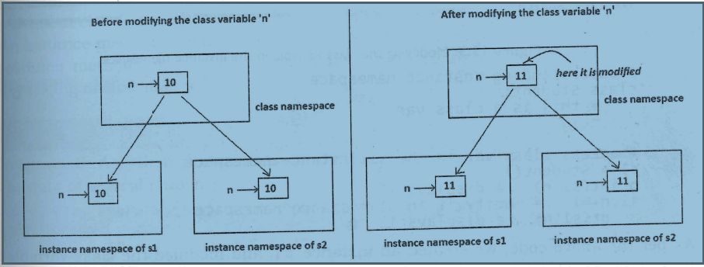

Slide 15
Understanding instance namespace
class Student:
# this is a class var
n=10
# access class var in the sl instance namespace
s1 = Student()
print(s1.n) # displays 10
sl.n+=1 # modify it in s1 instance namespace
print(sl.n) # displays 11
s2 = Student()
print(s2.n) # displays 10, not 11

Slide 16
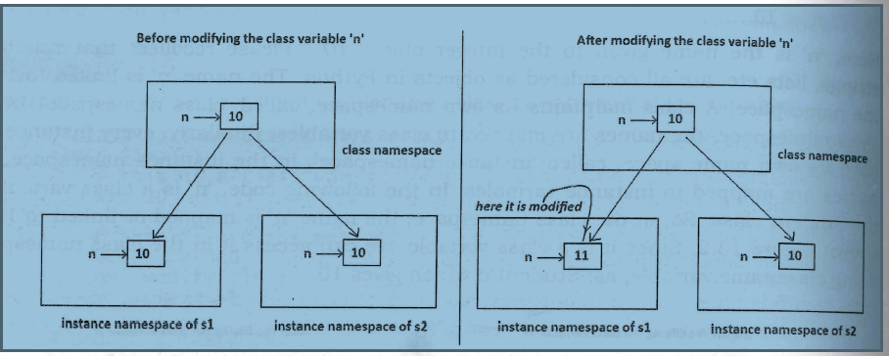

Slide 17
Type of Methods
We know that the variables declared in the class are called class variables (or static variables) and the variables declared in the constructor are called instance variables.
We can classify the methods in the following 3 types:
Instance methods
Accessor methods
Mutator methods
Class methods
Static methods

Slide 18
Instance methods
Instance methods are the methods which act upon the instance variables of the class.
Instance methods are bound to instances (or objects) and hence called as:
instancename.method()
Since instance variables are available in the instance, instance methods need to know the memory address of the instance.
This is provided through ‘self’ variable by default as first parameter for the instance method. While calling the instance methods, we need not pass any value to the ‘self’ variable
Accessor methods simply access or read data of the variable. They do not modify the data of the variable. Accessor methods are generally written in the form of getXXX() and hence they are also called as getter methods
Mutator methods modifies the variable values
Go to Jupyter notebook for examples

Slide 19
Class methods
These methods act on class level. Class methods are the methods which act on the class variables or static variables.
These methods are written using @classmethod decorator above them. By default, the first parameter for class methods is 'cls' which refers to the class itself.
For example, 'cls.var' is the format to refer to the class variable. These methods are generally called using the classname.method(). The processing which is commonly needed by all the instances of the class is handled by the class methods.
Go to Jupyter notebook for examples

Slide 20
Static methods
We need static methods when the processing is at the class level but we need not involve the class or instances.
Static methods are used when some processing is related to class but does not need the class or its instances to perform any work.
For example, setting environmental variables, counting the number of instances of the class or changing an attribute in another class, etc. are the tasks related to a class. Such tasks are handled by static methods.
Also, static methods can be used to accept some values, process them and return the result. In this case the involvement of neither the class nor the objects is needed. Static methods are written with a decorator @staticmethod above them. Static methods are called in the form of classname.method()
Go to Jupyter notebook for examples

Slide 21
Passing members of one class to another class
It is possible to pass the members (i.e. attributes and methods) of a class to another class. Let's take an Emp class with a constructor that defines attributes 'id', 'name', and `salary'. This class has an instance method display() to display these values. If we create an object (or instance) of Emp class, it contains a copy of all the attributes and methods. To pass all these members of Emp class to another class, we should pass Emp class instance to the other class. For example, let's create an instance of Emp class as:
e=Emp()
Then pass this instance ‘e’ to a method of other class, as:
myclass.mymethod(e)
Here, Myclass is the other class and mymethod() is a static method that belongs to Myclass. In Myclass, the method mymethod() will be declared as a static method as it acts neither on the class variables nor instance variables of Myclass.
Go to Jupyter notebook for example

Slide 22
Inner classes
Writing a class within another class is called creating an inner class or nested class.
For example, if we write class B inside class A, then B is called inner class or nested class. Inner classes are useful when we want to sub group the data of a class
Go to Jupyter notebook for examples

